Slide 1

Alaba ma EMS
Patient Care Protocols
Edition 9.01
January 2020
Change Summary
Southeast Alabama Emergency Medical Services
Notes:
Welcome to the Birmingham Regional EMS System June 2020 update of the Alabama EMS Patient Care Protocols 9.01. This material is simply an update to the protocols and should not substitute for a full protocol course should you need one. At any point should you have any questions concerning any portion of the protocol update feel free to reach out to the BREMSS staff.

Slide 2
Changed protocol numbers accordingly
The addition of Protocol 3.19 Hemodialysis Emergency Disconnect resulted in the re-numbering of subsequent protocols.
Protocols
3.19 - 3.36
Notes:
The first change involves the changing of protocol numbers accordingly. The addition of Protocol 3.19 Hemodialysis Emergency Disconnect resulted in the re-numbering of subsequent protocols.

Slide 3
Renumbered pages accordingly
The addition of content has required many pages to be re-numbered to reflect the current location of the materials in the 9.01 manual.
ALABAMA EMS
PATIENT CARE PROTOCOLS
EDITION 9.01
JANUARY 2020
Notes:
The addition of content has also required many pages to be re-numbered to reflect the current location of the materials in the 9.01 manual. These changes did not affect the section content through section 6 (the forms section). Section 7 is now the Tactical Paramedic section due to the removal of the critical care section.

Slide 4

Added Skills
1
Orogastric tube placement
BIADs and Capnography for EMTs
BiPAP
IO site for pediatrics
BIAD for pediatrics
Hemodialysis Emergency Disconnect
Decompression site
2
3
4
5
6
7
Notes:
Added skills found in the 9.01 edition of the Alabama EMS Patient Care Protocols include:
Orogastric tube placement
Blind insertion airway devices or BIADs and Capnography for EMTs
Bilevel Positive Airway Pressure treatment or BiPAP
An addition to the I.O. sites for pediatrics
BIAD for pediatrics
Hemodialysis Emergency Disconnect
And specification of Needle Decompression sites.

Slide 5
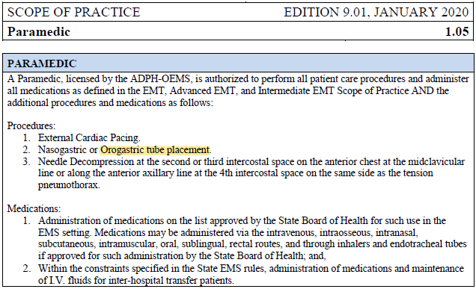
Added Orogastric tube placement to Paramedic Scope of Practice
Paramedic Scope of Practice 1.05
Page 8
Notes:
Orogastric tube placement has been added to the Paramedic Scope of Practice. This can be found under procedure #2 accompanying nasogastric tube placement.

Slide 6
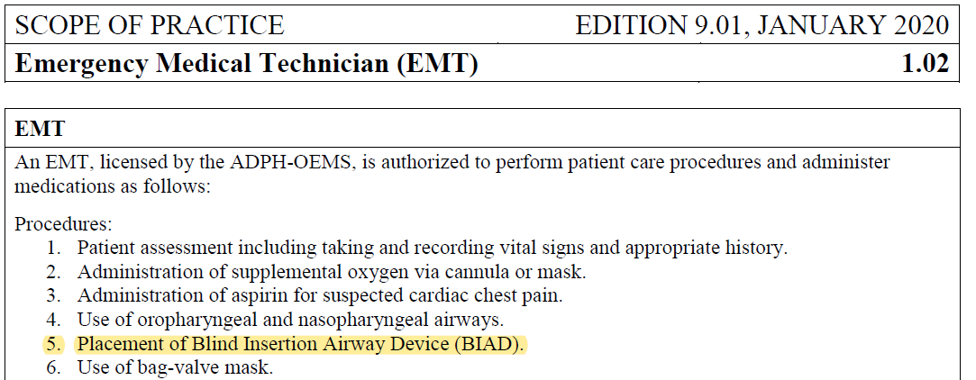
Added BIADs to the EMT Scope of Practice
EMT
Scope of Practice 1.02
Page 5
Procedure #5
Notes:
Blind insertion airway devices or BIADs have been added to the EMT Scope of Practice.
Common BIADs include the King airway, I-gel, and LMA.

Slide 7

BIAD: King LTS-D Airway (Design)

Slide 8
BIAD: King LTS-D Airway (Insertion)

Slide 9
BIAD: I-Gel Airway

Slide 10
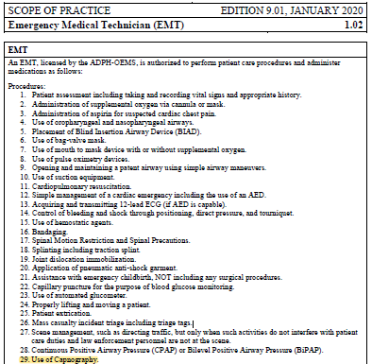
Added Capnography to the EMT Scope of Practice
EMT
Scope of Practice 1.02
Page 5
Procedure #23
Notes:
Capnography has been added to the EMT Scope of Practice. Service training officers and medical directors should ensure personnel are properly trained in use of your specific equipment utilizing manufacturer training materials.

Slide 11
Waveform Capnography 1

Slide 12
Waveform Capnography 2

Slide 13

Added BiPAP to approved interventions
Page 5 - EMT Scope of Practice #28
Page 49 - Congestive Heart Failure Treatment
Page 63 - Influenza/Respiratory Illness Key Points
Page 73 - Respiratory Distress Treatment and EMT Drugs/Procedures
Bilevel Positive Airway Pressure
Notes:
Areas in which Bilevel Positive airway pressure or BiPAP has been added to treatment regimens include:
Page 5 – EMT Scope of Practice #27
Page 49 - Congestive Heart Failure Treatment
Page 63 - Influenza/Respiratory Illness Key Points
Page 73 - Respiratory Distress Treatment and EMT Drugs/Procedures
Like previously mentioned under capnography, Service training officers and medical directors should ensure personnel are properly trained in use of your specific equipment utilizing manufacturer training materials.

Slide 14
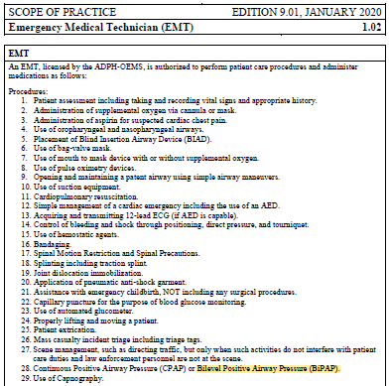
Added BiPAP to approved interventions
Page 5
EMT Scope of Practice #28
Notes:
BiPAP has been added to the EMT Scope of practice under procedure #28 with Continuous Positive Airway Pressure or CPAP.

Slide 15
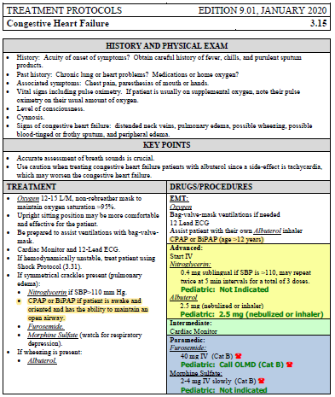
Added BiPAP to approved interventions
Page 49
Congestive Heart Failure
Treatment
Notes:
BiPAP has been added to the approved interventions for Congestive Heart Failure Treatment If symmetrical crackles present or pulmonary edema. The patient should be awake and oriented and have the ability to maintain an open airway.

Slide 16
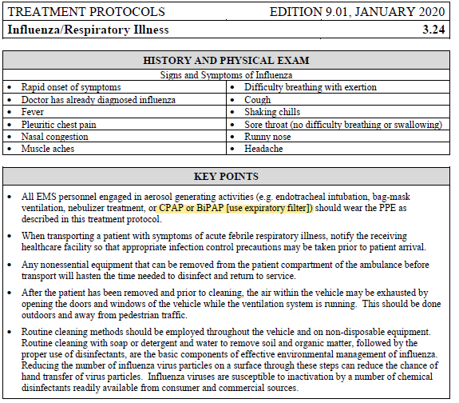
Added BiPAP to approved interventions
Page 63
Influenza/Respiratory Illness
Key Points
Notes:
BiPAP has been added to the approved interventions for Influenza or Respiratory Illness. It is important to understand the key point recommending EMS personnel wear the PPE described in this protocol if using BiPAP as a treatment measure. It is also important to use an expiratory filter.

Slide 17
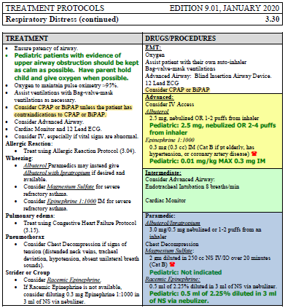
Added BiPAP to approved interventions
Page 73
Respiratory Distress Treatment and EMT Drugs/Procedures
Notes:
BiPAP has been added to the approved interventions for Respiratory Distress. BiPAP should be considered unless the patient has contraindications to its use. It is now an approved procedure for the EMT level.

Slide 18
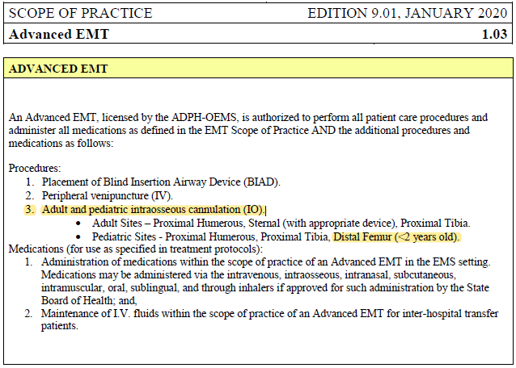
Added distal femur to approved IO site for pediatrics
Page 6
Advanced EMT Scope of Practice
#3
Notes:
The distal femur has been added as an approved I.O. site for pediatrics. This can be found under the Advanced EMT Scope of Practice procedures. The distal femur is approved for pediatric patients less than 2 years old.

Slide 19
IO Sites: Distal Femur for Pediatrics (EZ IO)

Slide 20

Added approval for BIAD for pediatrics
Page 55 (Head Trauma) –
Removed “Pediatric: Usually not indicated”
Page 62 (Hypothermia) –
Removed “Pediatric: Usually not indicated”
Page 66 (Near Drowning) –
Removed “Pediatric: Usually not indicated”
Page 73 (Respiratory Distress) –
Removed “Pediatric: Usually not indicated”
Notes:
The 9.01 edition of the Alabama EMS Protocols has added approval for the use of BIADs for pediatrics. This can be found in the following protocols:
Page 55 Head Trauma
Page 62 Hypothermia
Page 66 Near Drowning
Page 73 Respiratory Distress
This has been amended by removing the “Pediatric: Usually not Indicated” phrase under treatment.

Slide 21
Added Hemodialysis Emergency Disconnect
Page 56
HISTORY AND PHYSICAL EXAM
Some patients are now doing UNATTENDED (i.e. solo) home hemodialysis. In the event you respond to a scene where such a patient is unable to disconnect themselves from the machine, and no else is available who knows how to do so, follow this procedure to disconnect the patient from the machine for transport.
Notes:
A new protocol has been added to the 9.01 edition involving Hemodialysis Emergency Disconnect. The purpose of this protocol is due to some patients doing UNATTENDED home hemodialysis. In the event you respond to a scene where such a patient is unable to disconnect themselves from the machine, and no else is available who knows how to do so, the EMS personnel may follow this procedure to disconnect the patient from the machine for transport.

Slide 22
Added Hemodialysis Emergency Disconnect
Page 56
KEY POINTS
If time and patient condition permit, ALS backup should be called for BLS crews.
IF you are trained in using HD shunt clamps, and such clamps are available, it is acceptable to remove the HD needles from the patient’s shunt and apply clamps. If not, this procedure should be followed, leaving the needles in situ as described above and below.
The dialysis machine will be left at the home.
If you can, note (or photograph) any clinically relevant values on the machine’s readouts (such as liters removed).
For a patient with an AV shunt, the result of this procedure is that the patient still has the dialysis needles in their AV fistula, ATTACHED to CLAMPED tubing, which is wrapped with gauze to keep the needles and tubing next to the patient’s arm (unless HD shunt clamps are used).
Notes:
Important Key Points of this protocol include:
•If time and patient condition permit, ALS backup should be called for BLS crews.
•IF you are trained in using HD shunt clamps, and such clamps are available, it is acceptable to remove the HD needles from the patient’s shunt and apply clamps. If not, this procedure should be followed, leaving the needles in situ or the normal location as described above and below.
•The dialysis machine will be left at the home.
•If you can, note or photograph any clinically relevant values on the machine’s readouts, such as liters removed.
•For a patient with an AV shunt, the result of this procedure is that the patient still has the dialysis needles in their AV fistula, ATTACHED to CLAMPED tubing, which is wrapped with gauze to keep the needles and tubing next to the patient’s arm unless HD shunt clamps are used.

Slide 23
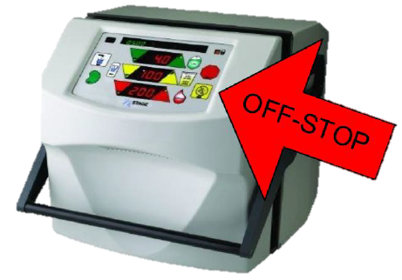
Added Hemodialysis Emergency Disconnect
Page 56
TREATMENT
PROCEDURE
Push the STOP button on the front of the machine and unplug the machine’s power cord.
Notes:
The procedures for performing a hemodialysis emergency disconnect are as follows:
First, push the STOP button on the front of the machine and unplug the machine’s power cord.

Slide 24
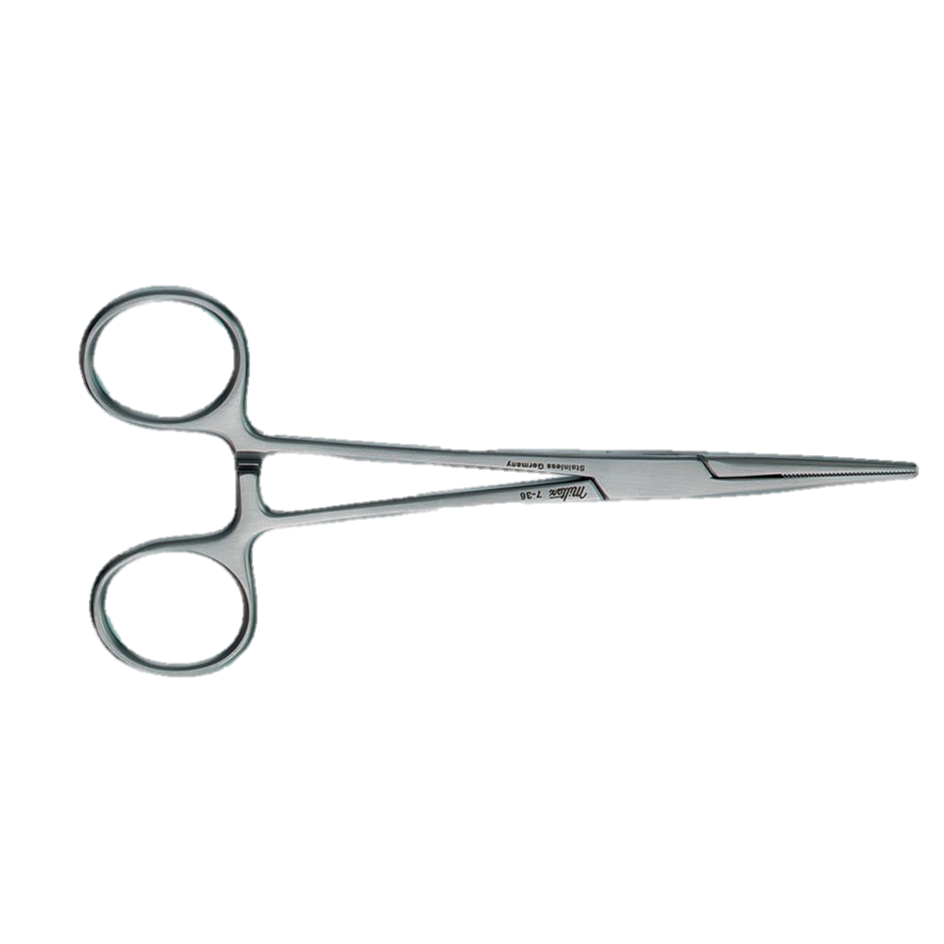
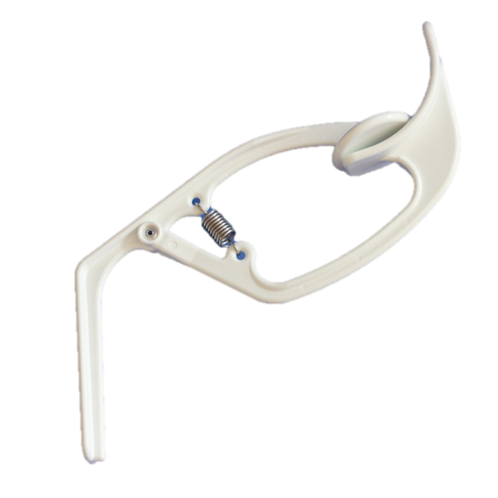
Added Hemodialysis Emergency Disconnect
Page 56
TREATMENT
PROCEDURE
Identify and close the 4 clamps on the tubing. If clamps are not on the tubing, use Kelly clamps or plastic clamps (which will usually be on or near the dialysis machine) to clamp off the 2 tubes both above and below the Luer lock disconnects.
Notes:
You should then Identify and close the 4 clamps on the tubing. If clamps are not on the tubing, use kelly clamps or plastic clamps which will usually be on or near the dialysis machine to clamp off the 2 tubes both above and below the luer lock disconnects.

Slide 25
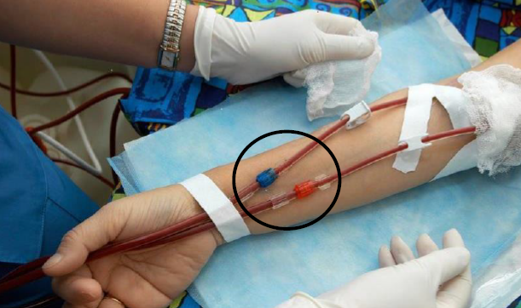
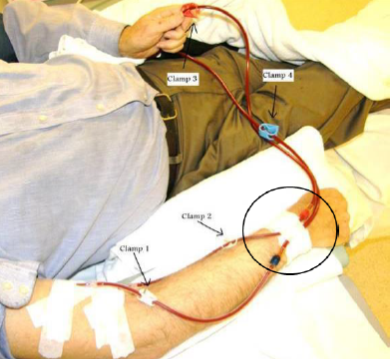
Added Hemodialysis Emergency Disconnect
Page 56
TREATMENT
PROCEDURE
The disconnects are in the center of the pictures below.
Notes:
Note the disconnects are in the center of the pictures below.

Slide 26
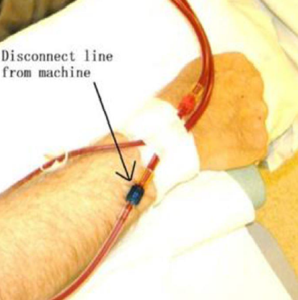
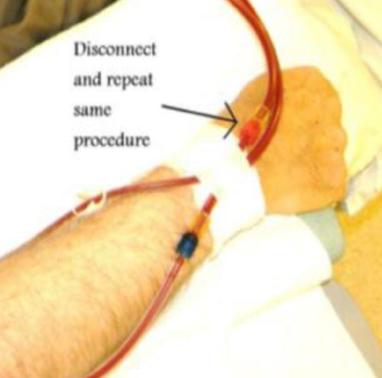
Added Hemodialysis Emergency Disconnect
Page 56
TREATMENT
PROCEDURE
Notes:
Disconnect the line from the machine. Repeat the procedure for additional connections.

Slide 27

Added Hemodialysis Emergency Disconnect
Page 56
TREATMENT
PROCEDURE
If you are trained to do so, and you have sterile caps or sterile syringes, or they are on or near the dialysis machine, then swab each disconnect end-connector with alcohol and attach the cap or syringe.
You will now have two needle-tubing pieces still inserted into the patient’s fistula. GENTLY tape the tubing to the patient’s arm, then LOOSELY wrap gauze around the arm. DO NOT apply a pressure dressing.
If you accidentally pull a needle out of the fistula, you will have to apply firm manual pressure (again, NOT a pressure dressing) to that bleeding point for approximately 20 minutes.
Be prepared to call for additional resources if needed.
Notes:
If you are trained to do so, and you have sterile caps or sterile syringes, or they are on or near the dialysis machine, then swab each disconnect end-connector with alcohol and attach the cap or syringe.
You will now have two needle-tubing pieces still inserted into the patient’s fistula. GENTLY tape the tubing to the patient’s arm, then LOOSELY wrap gauze around the arm. DO NOT apply a pressure dressing.
It is important to note that if you accidentally pull a needle out of the fistula, you will have to apply firm manual pressure to that bleeding point for approximately 20 minutes. Do NOT use a pressure dressing.
You should be prepared to call for additional resources if needed.

Slide 28
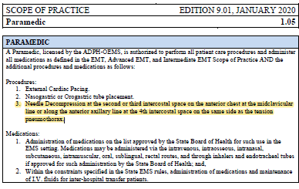
Decompression Site Added
Page 8 – Paramedic Scope of Practice. Procedure #3
Needle Decompression at the second or third intercostal space on the anterior chest at the midclavicular line or along the anterior axillary line at the 4th intercostal space on the same side as the tension pneumothorax.
Notes:
The 9.01 edition of the Alabama EMS protocols has added specifics to the sites allowed for needle decompression. Needle Decompression should be performed at the second or third intercostal space on the anterior chest at the midclavicular line or along the anterior axillary line at the 4th intercostal space on the same side as the tension pneumothorax. This addition can be found under the Paramedic scope of practice procedure #3.

Slide 29
Tactical Paramedic and Protocols
Page 131-Section 7
A paramedic endorsed by the OEMS, certified by the International Board of Specialty Certifications (IBSC) as a Tactical Paramedic-Certified (TP-C), and has been validated by the provider service Medical Director. This certification grants all protocols to be category A, an expanded scope of practice, and medication formulary only when the individual receives the current endorsement on their EMSP license issued by the OEMS and they are actively engaged in a tactical operation with a Law Enforcement agency.
Notes:
The Alabama EMS Patient Care Protocols 9.01 edition brings the addition of the tactical paramedic endorsement and establishes treatment protocols specific to this endorsement.
In Alabama the tactical paramedic is a paramedic endorsed by the OEMS, certified by the International Board of Specialty Certifications as a Tactical Paramedic-Certified, and has been validated by the provider service Medical Director. This certification grants all protocols to be category A, an expanded scope of practice, and medication formulary only when the individual receives the current endorsement on their EMSP license issued by the OEMS and they are actively engaged in a tactical operation with a Law Enforcement agency.
It is important to note that this protocol may only be used as stated in the 9.01 protocols.

Slide 30
Tactical Paramedic and Protocols
Surgical Cricothyroidotomy Protocol 7.01
Surgical cricothyroidotomy involves passing a tube through an incision in the cricothyroid membrane in order to provide an airway to oxygenate and ventilate a patient when less invasive airway management techniques cannot be accomplished or have failed.
INDICATIONS
Management of an airway when standard airway procedures cannot be accomplished or have failed.
PRECAUTIONS
Caution should be used in patients with:
• Laryngeal injury.
• Tracheal rupture.
• Anterior neck swelling that obscures anatomical landmarks.
• Anatomic anomalies or distortion of the larynx and trachea.
• Bleeding disorder.
Notes:
Tactical paramedics endorsed by the OEMS and actively involved in a law enforcement operation may utilize protocol 7.01 surgical cricothyroidotomy.
Surgical cricothyroidotomy involves passing a tube through an incision in the cricothyroid membrane in order to provide an airway to oxygenate and ventilate a patient when less invasive airway management techniques cannot be accomplished or have failed.
This procedure is indicated when management of an airway when standard airway procedures cannot be accomplished or have failed.
Caution should be used in patients with:
• Laryngeal injury,
• Tracheal rupture,
• Anterior neck swelling that obscures anatomical landmarks,
• Anatomic anomalies or distortion of the larynx and trachea, and or a
• Bleeding disorder.

Slide 31
Tactical Paramedic and Protocols
Surgical Cricothyroidotomy Protocol 7.01
PROCEDURE
Adult
Have suction supplies available and ready.
Locate the cricothyroid membrane utilizing anatomical landmarks.
Use the non-dominant hand to secure the membrane.
Prepare the site for incision. Quickly cleanse the site with antiseptic solution. Start from the membrane and wipe in widening circles until a broad margin around the site is cleansed.
Make a vertical incision in the skin 1.5 to 2.5 cm in length over the cricothyroid membrane.
Use blunt dissection to expose the cricothyroid membrane.
Once the membrane is exposed, make a horizontal incision through the membrane.
Insert the endotracheal tube until the cuff is in the trachea, inferior to the incision site. Consider the use of a Bougie as a guide into the trachea.
Inflate the cuff.
Secure the tube with a commercial tube holder if available or prepackaged tube securing tie.
Confirm placement as you would an ETT.
Note the depth on insertion.
Pediatric: Not Recommended.
Notes:
To perform a Surgical Cricothyroidotomy on an adult, the tactical paramedic should follow these steps:
•Have suction supplies available and ready.
•Locate the cricothyroid membrane utilizing anatomical landmarks.
•Use the non-dominant hand to secure the membrane.
•Prepare the site for incision. Quickly cleanse the site with antiseptic solution. Start from the membrane and wipe in widening circles until a broad margin around the site is cleansed.
•Make a vertical incision in the skin 1.5 to 2.5 cm in length over the cricothyroid membrane.
•Use blunt dissection to expose the cricothyroid membrane.
•Once the membrane is exposed, make a horizontal incision through the membrane.
•Insert the endotracheal tube until the cuff is in the trachea, inferior to the incision site. Consider the use of a Bougie as a guide into the trachea.
•Inflate the cuff.
•Secure the tube with a commercial tube holder if available or prepackaged tube securing tie.
•Confirm placement as you would an ETT.
•Note the depth on insertion.
This procedure is not recommended for pediatric patients.

Slide 32
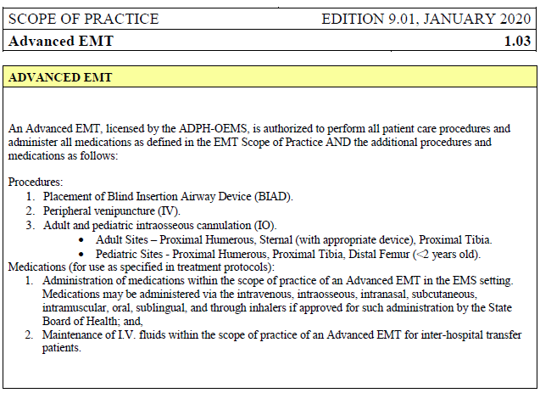
Changed medication list wording for Advanced EMT
Page 6
Advanced EMT Scope of Practice
Medications
Notes:
The 9.01 edition has changed the medication list wording for Advanced EMTs. This can be seen under the Advanced EMT Scope of practice. The new wording is as follows:
Medications, for use as specified in treatment protocols:
1. Administration of medications within the scope of practice of an Advanced EMT in the EMS setting. Medications may be administered via the intravenous, intraosseous, intranasal, subcutaneous, intramuscular, oral, sublingual, and through inhalers if approved for such administration by the State Board of Health; and,
2. Maintenance of I.V. fluids within the scope of practice of an Advanced EMT for inter-hospital transfer patients.
It is also important to note that each EMSP scope of practice no longer contains a list of approved medications for use at that level. You should view the individual medication protocol for further information pertaining to specific use.

Slide 33
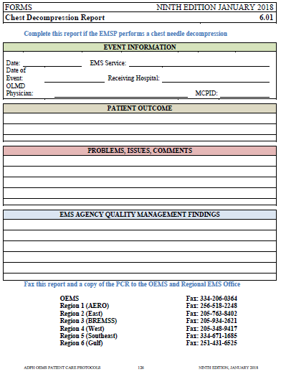
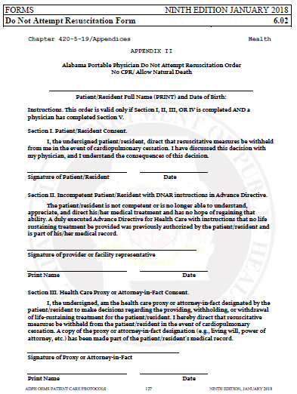
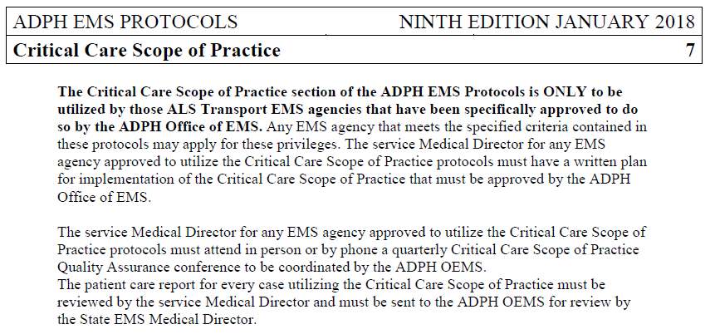
Removed from Protocols
1
2
3
Needle Decompression Form
DNR Form
Critical Care Section
Notes:
The 9.01 edition of the Alabama Patient Care Protocols does not contain these 3 items previously found in the 9th edition protocols. The Needle Decompression Form, DNR form, and Critical Care Section have all been removed from the 9.01 protocols. If you are endorsed by the office of EMS as a critical care paramedic you should view the separate Alabama EMS Critical Care Patient Care Protocols.

Slide 34

Southeast Alabama Emergency
Medical Services Council, Inc.
www.seaems.com
Alabama EMS Patient Care Protocols
Edition 9.01
January 2020
Change Summary
Notes:
This concludes the change summary for the 9.01 edition of the Alabama EMS patient care protocols. If you have any questions or issues please reach out to the BREMSS staff or the ADPH Office of EMS staff.

